Slide 1
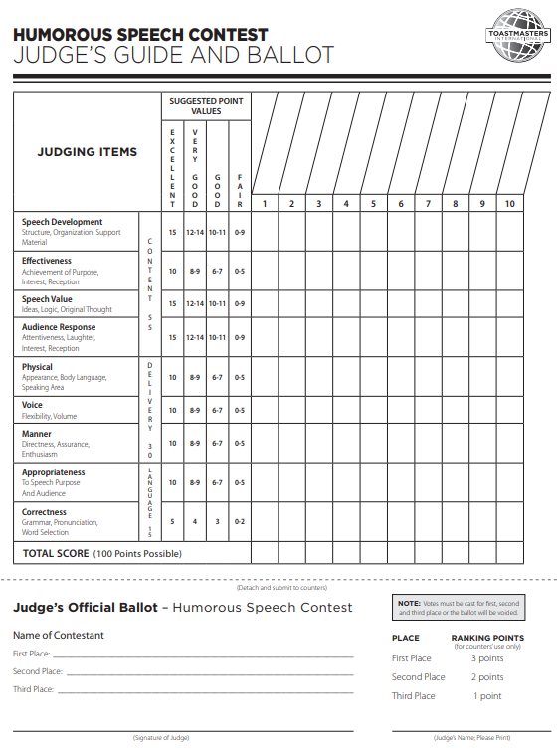
District 48
Club, Area, Division info
2018 Humorous Speech Contest
Day / Date / Time
Location

Slide 2
Contest Date
Humorous
Speech Contest
Name, credentials Contest Chair
Name, credentials Contest Master
Name, credentials Chief Judge
Confidential Judges
Name, credentials Timer
Name, credentials Timer
Name, credentials Ballot Counter
Name, credentials Ballot Counter
Name, credentials Ballot Counter
Contestants
Speaking Order | Name | Final Results
For Upcoming Contest Information
Visit www.district48.org > District Events > Area Contests and Division Contests
All Division winners will advance
to the District Contests at our
2019 Spring Conference
Waves of Opportunity
April 26 – 28
Tampa Airport Marriott
4200 George J Bean Pkwy, Tampa, FL 33607

